Slide 1
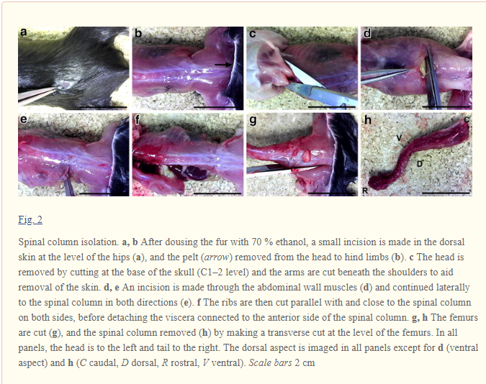
1) Excise Spine:

Slide 2
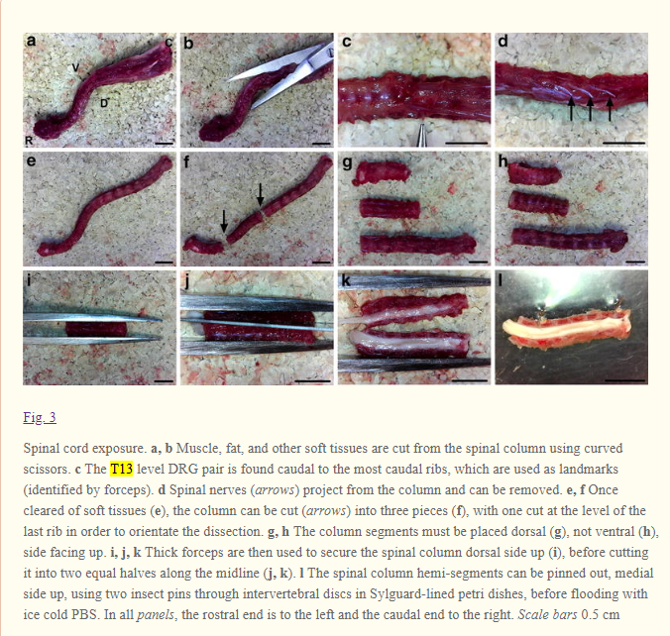
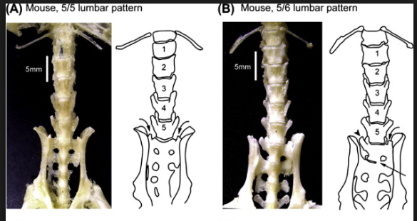
2) Expose Spinal Cord
Orientation based on
most caudal rib:

Slide 3
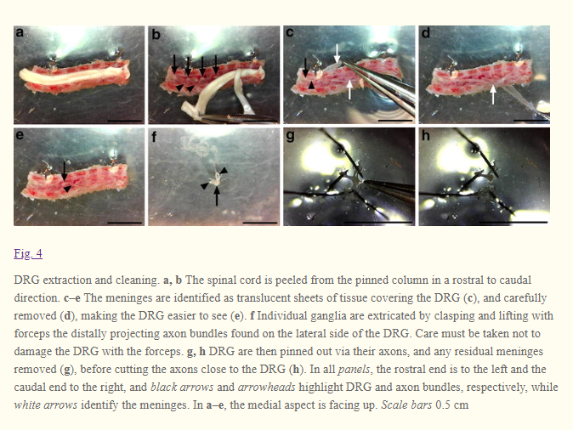
3) DRG Extraction:
Note: DRG may come off
with meninges. This is
okay. Pin meninges
flat and gently remove
DRGs
Remove L2-L5 for best
estimation of sciatic
nerve.

Slide 4
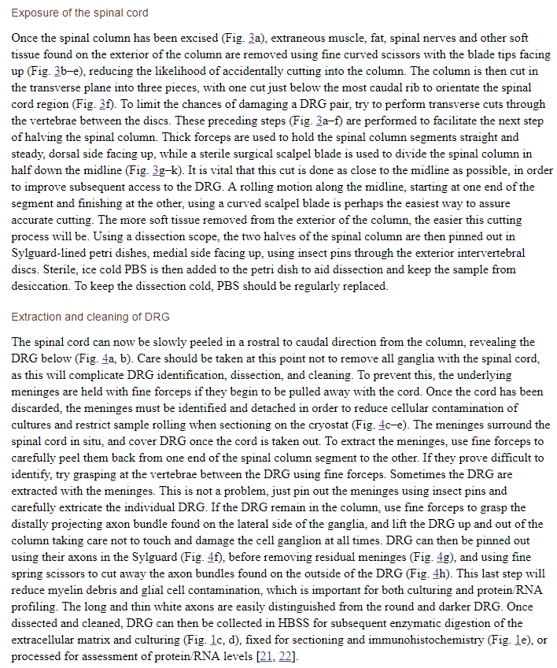
Further details:

